Slide 1
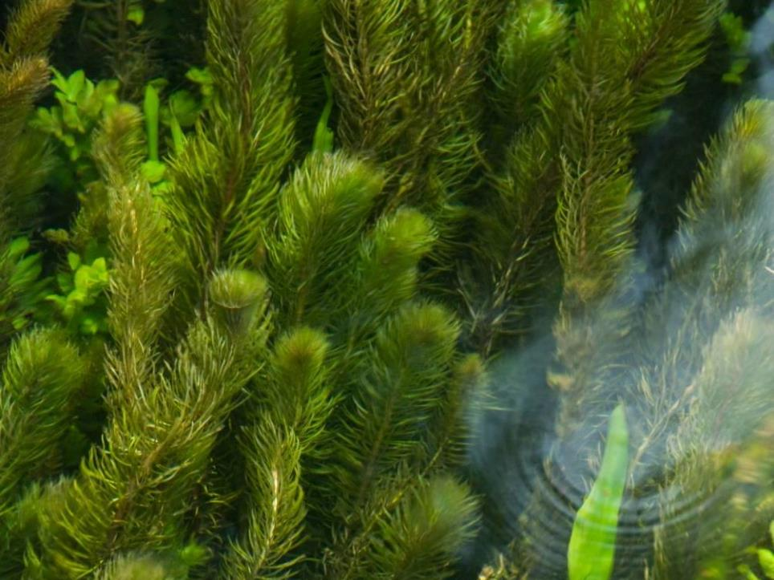
FRESHWATER INVASIVE NON-NATIVE SPECIES
Name of presenter

Slide 2
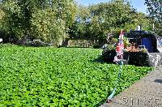
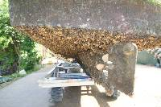
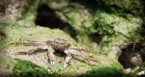
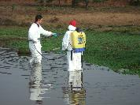
Freshwater Invasive Non-Native Species
Impacts on Volunteers and Practical Biosecurity Actions
Notes:
Images © GB NNSS

Slide 3
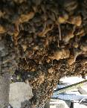
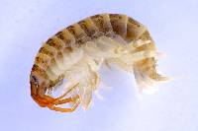
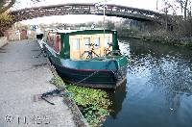
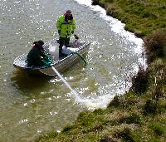
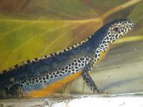
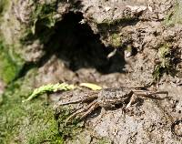
What are Non-Native Species?
Non-Native Species (NNS) are outside their normal / native range because of people.
Non-native Species becoming a problem are called ‘invasive’ (INNS).
NNS can also be called ‘non-indigenous’ or ‘alien’ species (IAS: Invasive Alien Species)
Images: Alpine newt © Anevrisme; Hydroctyle ranunculoides weed extraction boat, Crown Copyright 2009; Rotenone application © Matt Brazier, Environment Angency; Killer shrimp © Environment Agency; Mitten crab © GB NNSS, Zebra mussels © Crown Copyright 2009;
Notes:
I’m going to talk to you today/tonight about the threat from invasive non-native species, or INNS, in the freshwater environment and what we can do about it. I have a presentation which will take about half an hour which I hope will give you a useful insight into the world of invasive non-native species. I am happy to take questions at the end.
By the end of this short presentation I hope I will have given you not only a useful insight into the world of invasive species but also shown you that there are many actions we can all take to reduce the risk of their spread and reduce the impact of their growth.

Slide 4
Notes:
Link to YouTube video. Requires web access and may take a minute to load and play.
Here is the link in case the one within the Powerpoint doesn’t work: https://www.youtube.com/watch?v=EoggtzYr4Qk

Slide 5
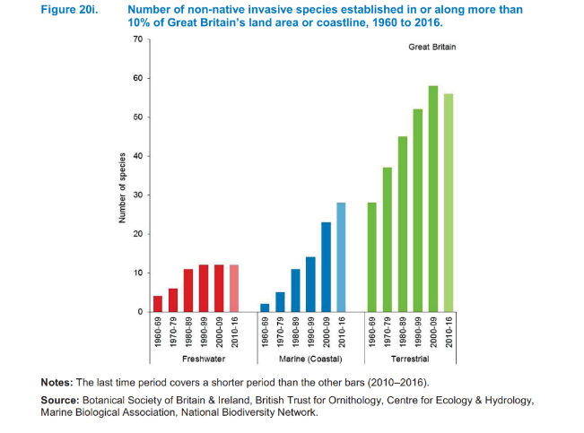
Ever Increasing Invasives
Notes:
Invasive non-native species are increasing across the UK, both in the sea and on the land, more than 10 per cent of Great Britain’s land area or coastline now has established populations of invasive species.

Slide 6
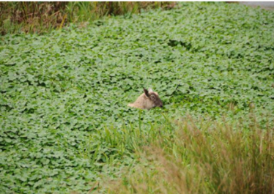
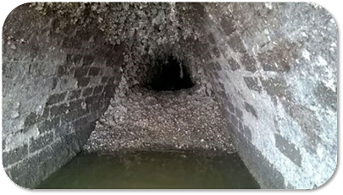
Economic Impact
£1.7bn cost to British economy annually
Likely to be a large under estimate
At least £23 million annually for 7 freshwater invasive plants
Annual cost of zebra mussels to industry in North America is estimated to be $5 billion and numbers are expanding in UK
Early eradication of water primrose would cost £73 thousand compared to £242 million that it would likely cost if fully established as in France and Belgium
‘Figures based on The Economic Cost of Invasive Non-Native Species on Great Britain, F. Williams, R. Eschen, A. Harris, D. Djeddour, C. Pratt, R.S. Shaw, S. Varia, J. Lamontagne-Godwin, S.E. Thomas, S.T. Murphy, CAB/001/09 November 2010’
Notes:
The estimated cost across the Great Britain is £1.7 billion; big impacts in freshwater habitats.
But SO WHAT?!
Photos: sheep in floating pennywort, Trevor Renals, NE; zebra mussels in water pipe, Thames Water; used with permission

Slide 7
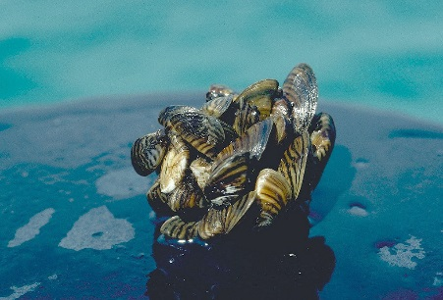
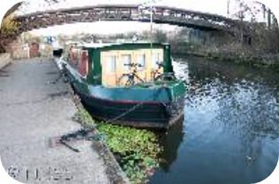
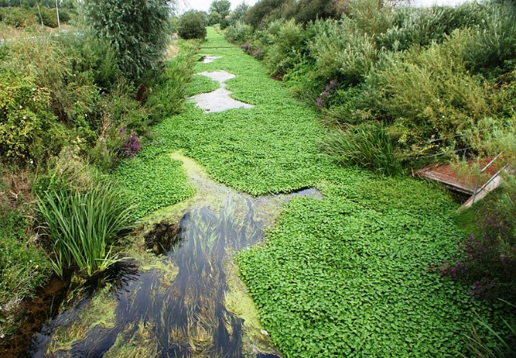
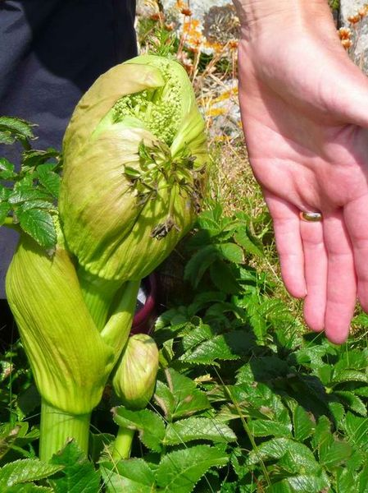
Loss of amenities….cost to industry….habitat destruction
Notes:
As a volunteers manager on a local club or service, be that a canoeing club, angling club or other organisation using open water bodies, your actions have the potential to introduce and spread invasive non-native species.
This can have a significant negative impacts on the natural environment which you enjoy and reply upon, and it can also lay you open to criticism and potentially even prosecution. It may also lead to restrictions being placed on your activities, for example restricted access to sensitive or protected areas.
The clubs and associations you facilitate, or are part of, play a vital social and economic role. They give better access to the outdoors and encourage participation in sport and we in no way want to lessen your enjoyment of them or the freshwater environment.
However, they also have the potential to import or spread invasive species and, with new laws in place in many countries, you need to understand your responsibility to minimise the risk.
Photo: Zebra mussels, D. Jude, University of Michigan, Creative Commons; Hydroctyle ranunculoides weed extraction boat, Crown Copyright 2009; Rotenone application © Matt Brazier, Environment Agency; Gordon Brown / Giant Hogweed bud / CC BY-SA 2.0; Floating pennwort, Simon Mortimer, CC BY-SA 2.0

Slide 8
Schedule 9 example species
Chinese Mitten Crab Eriocheir sinensis
Large-mouthed Black Bass Micropterus salmoides
Rock Bass Ambloplites rupestris
Bitterling Rhodeus sericeus
Noble Crayfish Astacus astacus
Signal Crayfish Pacifastacus leniusculus
Turkish Crayfish Astacus leptodactylus
American Mink Mustela vison
Alpine Newt Triturus alpestris
Italian Crested Newt Triturus carnifex
Pumpkinseed (Pond perch) Lepomis gibbosus
Wels (European catfish) Silurus glanis
Zander Stizostedion lucioperca
BIOSECURITY PLAN
----------------------------------------------------------------------------------------------------------------------------------------------------------------------------------------
-----------------------
-----------------------
-----------------------
------------------------------------------------------------------------------------------------------------------------------------------
----------------------------------------------
Notes:
The law in the UK varies. In England The Wildlife and Countryside Act 1981, and its various amendments, is the most important piece of legislation dealing with INNS.
The Act makes it illegal to release, plant or allow to escape into the wild any animal or plant which is not ordinarily resident, or a regular visitor to Great Britain, or is listed in Schedule 9 of the Act. Don’t worry too much about lists – getting caught up in identifying every species can be a fascinating, but lengthy, distraction!
You may also be aware of other pieces of legislation such as The European Strategy for Invasive Alien Species, the EU Invasive Alien Species regulation or the European Water Framework Directive.
The key thing to remember is that throughout the UK the principle of ‘polluter pays’ remains in force. Should the introduction of an invasive non-native species be attributed to your event there is the potential for you to be held accountable for the clean-up.

Slide 9
Demonstrate you have followed ‘best practice’
Aiming to demonstrate action against statements such as:
“Adopt a precautionary approach”
“Carry out risk assessments”
“Seek advice and follow good practice”
“Take reasonable steps and exercise due diligence”
Notes:
Avoiding this situation is not as difficult as you may at first suspect.
Controlling INNS can be very difficult and so legislators have avoided being too prescriptive about how to do it. Instead they request people ‘follow best practice’, mostly allowing users to define what is most appropriate for themselves.

Slide 10
Public Expectations
Legal Challenge
Investor
Confidence
Members Expectations
Market Advantage
Risk Management
Planning
Restrictions
Legislation
Suppliers
Environmental
Damage
Customers
Reputation
European Water Framework Directive
Wildlife and Countryside Act 1981
Notes:
Other reasons to take INNS seriously include the public perception of your sport, members’ interests and donors or supporters of your sport. Each of these key audiences have, over time, become more aware of the need to be seen to be more environmentally aware.
The reputational gains from being a sustainable organisation are significant and many partners and donors will expect to see you taking steps to reduce the impact of your activities including producing environmental or sustainability charters, for example.

Slide 11
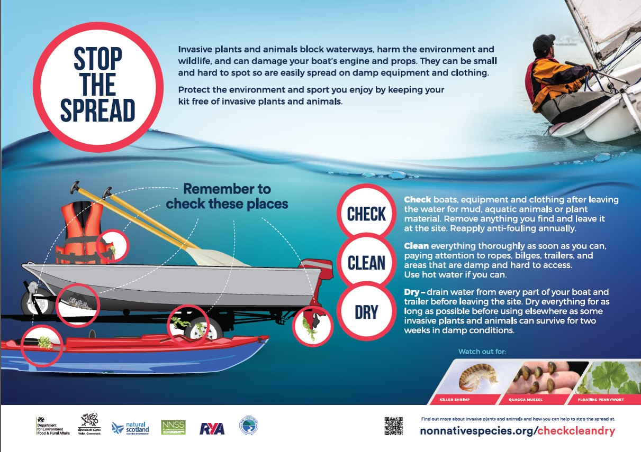
Check, Clean, Dry
Notes:
Helping managing a club is time consuming and complex. The last thing you want is another task to add to the list. However, if you introduce practical measures to reduce biosecurity risks into the day to day running of your club you will soon discover that it will become second nature and save you a lot of effort in the long run.
The essence of good biosecurity is to identify the high-risk activities and then ensure that everyone plays their part in reducing that risk.
Any time you enter and leave an area around a water body, you run the risk of moving INNS from one site to another.
Even a relatively small change of location can mean the difference between an INNS becoming invasive or staying relatively under control, so it is important for you to follow the best practice that we talk about here. Invasive plant seeds and fragments can travel greater distances on boots than by wind; many species can survive for several weeks in damp conditions.
The first mantra is Check : Clean : Dry
Check your kit, boat, trailer, etc for plants, animals and sediments. This may sound a little unlikely, but experienced anglers may recognise the stories of cleaning killer shrimp off their waders or canoeists finding fragments of plants caught on oars or in water inside the boat.
Clean anywhere on your trailer which could contain water or sediments such as inside the box frames of trailers, on the boat supports or under the wheel arches. Clean off all of the above by washing thoroughly, well away from the water’s edge.
Dry as much as you can as often as you can. From dinghies to waders, from life jackets to rods and nets, rinse them, dry them off and let the air get at those invasives – full desiccation kills most all invasive freshwater species!

Slide 12
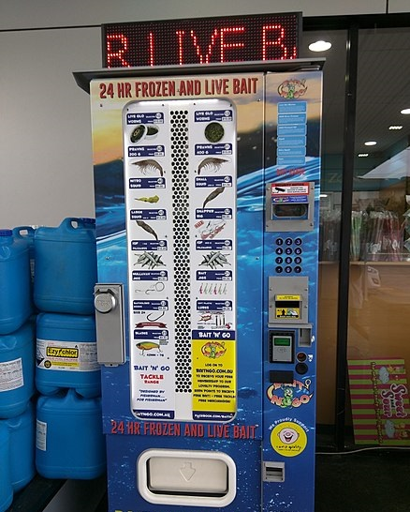
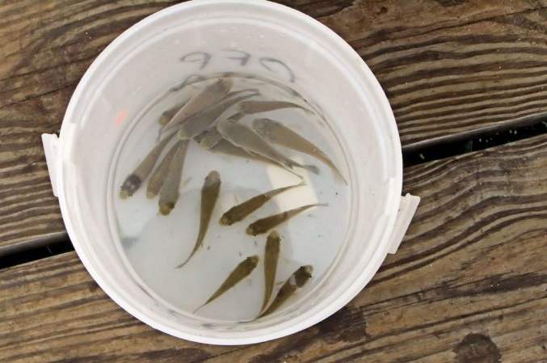
Local bait
Non-native species used as bait may spread INNS
A study in 2014 found:
16% of UK anglers collected bait at a different site than where they used it
7% released unused bait from a different site into the river/lake
Only use native bait, ideally sourced locally
Notes:
Reference: Anderson, L. G., White, P. C. L., Stebbing, P. D., Stentiford, G. D., & Dunn, A. M. (2014). Biosecurity and Vector Behaviour: Evaluating the Potential Threat Posed by Anglers and Canoeists as Pathways for the Spread of Invasive Non-Native Species and Pathogens. PLoS ONE, 9(4), e92788. http://doi.org/10.1371/journal.pone.0092788
Images: live bait fish, https://creativecommons.org/publicdomain/zero/1.0; bait vending machine, Maksym Kozlenko, CCA

Slide 13
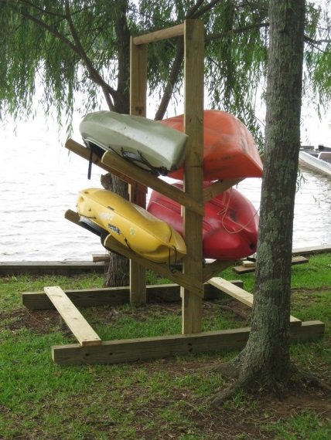
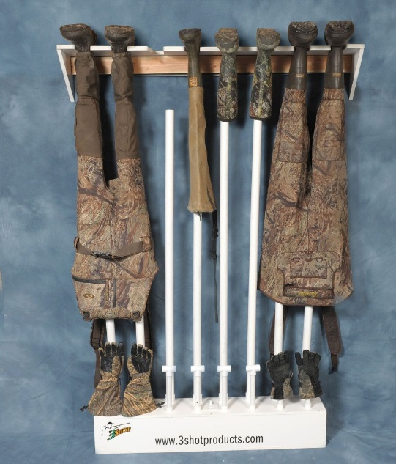
Drying racks
Provide drying racks near entry and exit points
Install racks and a dehumidifier in an indoor room for waders, wetuits and boots
Post “Check, Clean, Dry” information in these areas
Notes:
If you are responsible for facilities at the location, consider installing racks for people to drain and dry equipment. This could be near the entry and exit access points for canoes, or in a small room in a clubhouse or bait store for waders and boots. Inside, consider installing a dehumidifier which will speed up drying considerably.
Photo credits: Photo © Gander Mountain Gear; Photo ©jaxkayakfishing.com

Slide 14
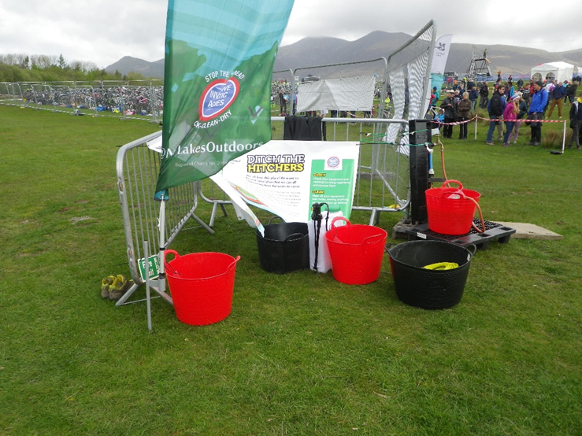
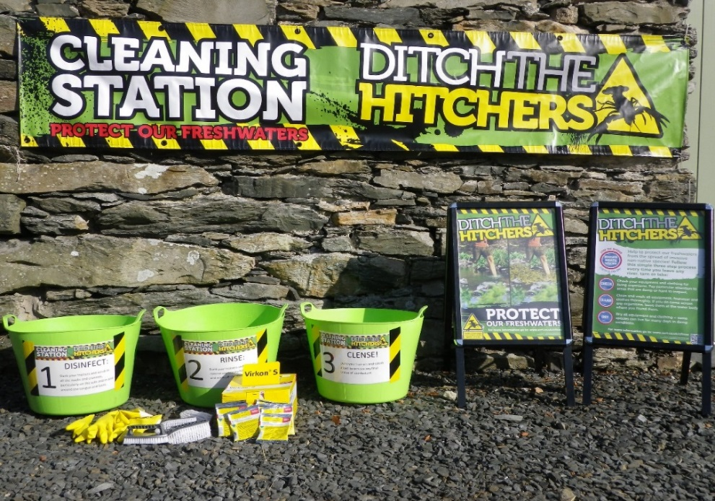
Washing station
Portable washing station with three buckets:
first for removing mud or other organic material
second for cleaning thoroughly
third for rinsing
Change water often and dispose of appropriately!
Notes:
If you are holding an event such as a tri-athlon or kayaking competition, you can create a portable washing station, if there is not an easily accessible washing station on-site.
Photos: CFINNS, used with permission

Slide 15
Reporting
Encourage an open culture of reporting unusual sightings including photographing and recording extent and lat/long.
Establish a single point of contact for INNS with local Natural England staff.
Submit reports via iRecord or alertnonnative@ceh.ac.uk
Notes:
And finally – report your concerns.
Much like safety, encourage a reporting ethos within your group or club.
Raise awareness of key INNS by circulating species information and updates and ask people to report anything which concerns them. Quite often you can find someone in your club with identification experience, if not report anything you can’t easily identify to alert_nonnative@ceh.ac.uk and let the experts take a look.

Slide 16
Working in Partnership
Identify a partner organisation who has the expertise to assist with identification of INNS.
Encourage ‘open access’ recording of INNS by researchers, students, volunteers and amateur taxonomists.
Notes:
You may find it helpful to seek opportunities to work in partnership with research organisations or conservation groups to improve monitoring, training and reporting for your volunteers and members. Encourage INNS researchers, students, volunteers and amateur taxonomists to use your site and to share their findings with you.

Slide 17
Recording your actions
Understand your site
Understand how INNS are introduced to your site
List site activities
List biosecurity measure
Contingency, monitoring and surveillance
Biosecurity Planning
Remember
Stay practical and cost aware
Follow best practice
Notes:
So how does all this relate to the legislation we discussed earlier?
In essence, by undertaking these actions you are demonstrating ‘best practice’. By recording it all in one document – your biosecurity plan – you can show anyone who may have concerns about your activities that you are taking all reasonable steps to lower the risk of your club introducing or spreading invasive non-native species.
Biosecurity Planning
You can take this one step further and do a full biosecurity plan for your club or mooring association. This involves a five step process which outlines why you are doing a biosecurity plan what geographical area or activity is to be covered and who has responsibility for the Plan, the physical characteristics of the area, the major types of activity you expect at the club or for the members to undertake and that you outline the actions you plan to take to improve your biosecurity. Aim to stay practical – you can always include a ‘wish list’ of other actions should time and budget allow.

Slide 18
Biosecurity Actions
Encourage participants to arrive and depart with clean, dry equipment.
Always wash down well away from the water’s edge to ensure that no residues can return to the water body.
Encourage reporting of unusual sightings.
Designate a Biosecurity Officer for events and brief all event staff.
Notes:
Biosecurity Actions / Control measures
For any activity that the club is supporting, outline the actions you plan to take to improve your biosecurity. We’ve discussed some of these actions already and what you choose to do will vary depending upon the activities and partners involved and the risk associated with the activities and the site. Aim to stay practical – you can always include a ‘wish list’ of other actions should time and budget allow.

Slide 19
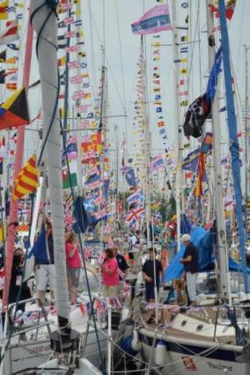
Commonwealth Games Flotilla 2014
Commonwealth Games Flotilla © S Brown
Notes:
You may have been listening to all this and thinking ‘but does anyone really DO this?’. Let me give you a short case study before we have a chance for questions.
In 2014 the Commonwealth Games were held in Glasgow. RYA Scotland felt this was too good an opportunity to miss and that, despite not being an official sport of the Commonwealth Games, boating should not be missed off the highlights list.
They got busy planning a flotilla of boats of all sizes to sail up the Clyde to the heart of the city. Very soon they had more than 200 boats signed up from all across the UK and as far afield as Northern Europe.
In the run up to this period the ‘Code of Conduct’ that accompanied the revised Wildlife and Natural Environment Act was released. The Code recommended that biosecurity planning would be considered best practice and spelt out the new powers under the Species Control Orders now available to the Scottish Government. These included impounding vessels and closing harbours.

Slide 20
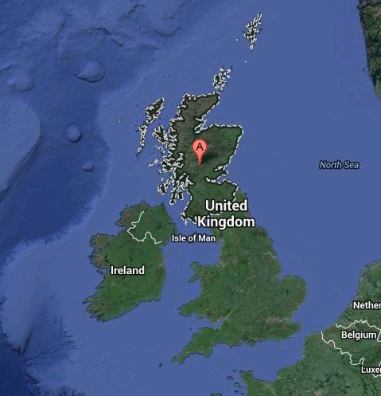
Sources of boats
Notes:
RYA Scotland sensibly decided to protect themselves by doing a biosecurity plan for the Flotilla which was now almost 250 boats strong. Working with the Firth of Clyde Forum they gathered publicly available data about salinity and water chemistry in the Clyde before assessing the available wash down facilities local to the venue.

Slide 21
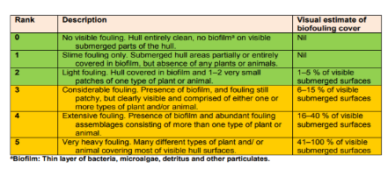
Critical Control Points
Pre departure preparation
Pontoon Contracts
Intervention Points
James Watt Dock
Contingency plan – Polluter Pays
Salinity – Peelports Data
Greenock 1.0182
Clydebank (Rothesay Dock) 1.0065
Glasgow King George V Dock 1.0055
Glasgow Broomielaw 1.0045
Plain water = 1.0
Greenock = fully saline, Broomielaw = almost fully fresh
GUIDANCE FOR PRODUCING SITE AND OPERATION-BASED PLANS FOR PREVENTING THE INTRODUCTION AND SPREAD OF INVASIVE NON-NATIVE SPECIES IN ENGLAND AND WALES. November 2015, R.D. Payne, E.J. Cook, A. Macleod & S. Brown
Notes:
In putting the Plan together they identified that the closest wash down was at James Watt Dock, the muster point prior to the final destination – this was then declared as the ‘Critical Control Point’ and volunteers were asked to keep an eye out for any boats with more than a sign of slight hull fouling as they arrived in the Dock. It was agreed that anyone arriving with hull fouling over level 3 would be asked to haul out and clean their boat or face not being allowed to join the flotilla.
In assessing the water chemistry the team realised that the boats were coming from an entirely maritime environment into one which was almost completely freshwater. This further reduced the risk of viable invasive species being introduced to the upper reaches of the Clyde.

Slide 22
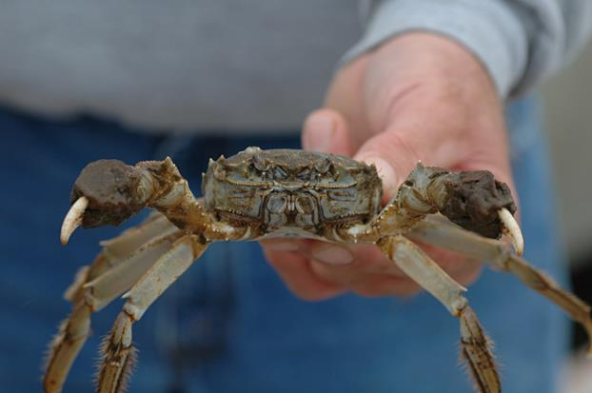
Not a moment too soon…..
Image © Greg Ruiz/Smithsonian permission requested - https://serc.si.edu/users/gregory-ruiz/ruizg6132002
Notes:
On the day no boats arrived unclean, perhaps due to the nature of the event, but also thanks to the communications sent to boat owners in the run up to the event by The Green Blue.
The event went brilliantly and the biosecurity plan made the headlines, not just because it was the first of its kind, but also because it was needed when just weeks later a Chinese Mitten crab was found in the River. RYA Scotland was able to rest easy showing they had a biosecurity plan which exonerated them from potential blame.
So, as you can see, biosecurity planning can be relatively easy to achieve and can protect you and your event from possible reputational and legal risks.

Slide 23
Contacts
Report INNS sightings by using iRecord (https://www.brc.ac.uk/irecord/ or the iRecord app) or by emailing alertnonnative@ceh.ac.uk
GB Non-Native Species Secretariat www.nonnativespecies.org
National Biodiversity Network – Distribution maps and information www.nbnatlas.org
RAPID LIFE: www.nonnativespecies.org/rapid
Notes:
I’d welcome any questions and if I can’t answer any of them I promise to make a note and get back to you with answers as soon as possible.

