Slide 1
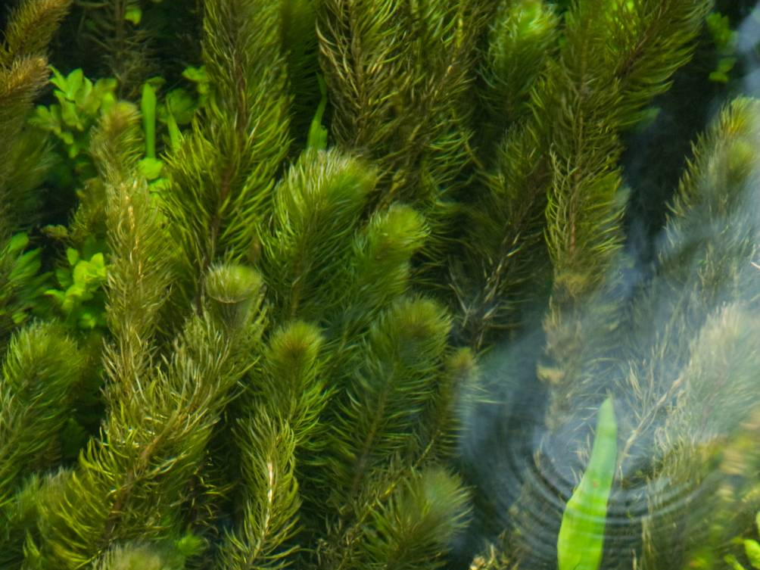







Vertebrate INNS: Ecology and Impacts
Name of presenter

Slide 2

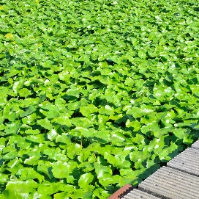
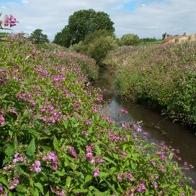
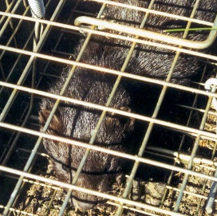
Invasive Non-Native Vertebrates
This presentation covers the following invasive non-native species (INNS):
North American Bullfrog
African Clawed Toad
Ruddy Duck
Sacred Ibis

Slide 3
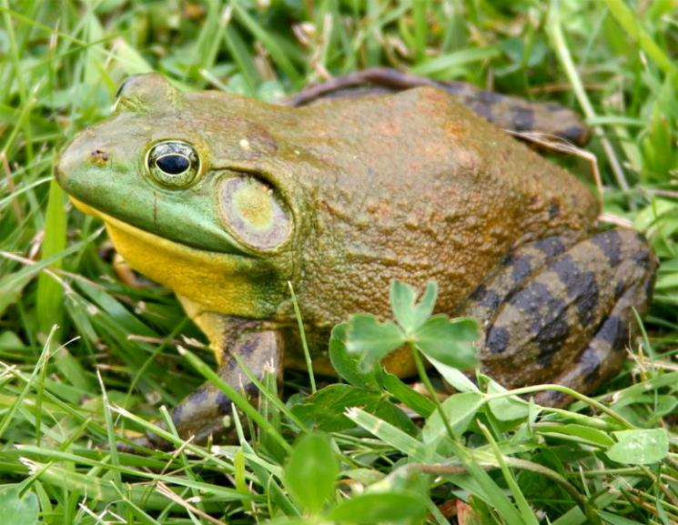

North American Bullfrog
Lithobates catesbeianus
Ear drum usually larger than eye with obvious skin fold above
No ridges along the back, unlike other frogs
Very large – up to 20cm long
Very distinctive cow-like call
Photo by Carl Page
Tadpoles are very large – up to 15cm compared to 4cm for Common Frog
By Carl D. Howe - Carl D. Howe, Stow, MA USA, CC BY-SA 2.5
Notes:
Its size, obvious eardrum and lack of longitudinal skin folds on the back make this frog relatively easy to recognise. It is easily disturbed so try observing it using binoculars or identifying it from its characteristic calls.
Adult males produce a low pitched, droning “rumm...rumm...rumm” call (sound recording embedded in slide), whilst juveniles have a distinctive squeak when disturbed. Usually heard from May until September. Bullfrogs hibernate from October-March underwater. There are no known predators of adult bullfrogs in the UK, but potentially include large carnivorous fish, mustelids and herons, and some cannibalism has been noted in high-density areas.

Slide 4
North American Bullfrog
Lithobates catesbeianus
Confusion Species: Common Frog Rana temporaria
Longitudinal skin folds along back
Maximum 10 cm long – nearly half the size of American Bullfrog
Ear drum equal to or smaller than eye and surrounded by dark mask, with no obvious skin fold above
Very common across the UK
© GBNNSS
Notes:
There are a few species that could potentially be confused with the American Bullfrog. One is the Common Frog

Slide 5
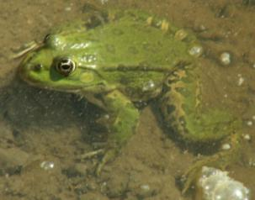
North American Bullfrog
Lithobates catesbeianus
Confusion Species: Marsh Frog Pelophylax ridibundus
Obvious ridges along back
Overall green body, females can be brown
Size between that of Common Frog and American Bullfrog, usually 10-13cm. Tadpole 8cm long.
Ear drum smaller than eye
Very different vocals to American Bullfrog
Well established in some parts of south-east England and becoming more common elsewhere
© GBNNSS
Notes:
There is considerable sexual dimorphism between male and female bullfrogs and often an audio recording of a call is more useful than a fuzzy photo at dusk.

Slide 6
North American Bullfrog
Lithobates catesbeianus
Survives in a variety of freshwater habitats, including garden ponds, lakes and slow-moving rivers and streams.
Only known from a few locations in Britain, mainly south-east England. As of April 2018, all populations have been eradicated.
Introduced mainly through pet trade.
Illegal to release intentionally or accidentally.
Notes:
Native to eastern North America. Introduced west of Rockies and in over 25 countries around the world.
Potentially found in any freshwater pool or river that is unlikely to dry out. These tend to be avoided as year-long water needed for hibernation.
Introduced to the UK mainly through the pet-trade, either deliberately or from garden ponds where they were introduced as tadpoles. First found in 1996. Only known from a couple of locations in England. At least 9000 animals were removed in 2004. A further population was discovered in Essex, where 100 were removed in 2007 but just 5 in 2008, suggesting the population had been greatly reduced. No further breeding has been noted, but some individuals have been seen in SE England.
Capable of travelling across arid land to colonise new water bodies. Froglets have been noted travelling up to 6 miles in just a few weeks.
North American bullfrog is listed under Section 14 of the Wildlife and Countryside Act 1981 in respect to England, Wales and Scotland. As such it is an offence to release or to allow the escape of this species into the wild.

Slide 7
North American Bullfrog
Lithobates catesbeianus
Impacts:
Voracious predator - takes fish, amphibians and even waterfowl chicks. Native species have no evolutionary defence mechanisms.
Acts as a vector to chytrid fungus, which is lethal to most amphibians but not the American Bullfrog.
Notes:
A predator that feeds day and night on a wide range of small animals, including amphibians, fish, small mammals, ducklings, small birds, molluscs, crustaceans and insects. Therefore pose a threat to native species in the UK.. Has been implicated in the decline of smaller, native amphibian species elsewhere in the world.
Bullfrogs are known carriers of the chytrid fungus Bactrachocytrium dendrobatidis. This can cause the disease chytridiomycosis which seriously affects some amphibian species and is potentially responsible for the decline or extinction of at least 200 species of frog worldwide. Cases of chytrid infection have been discovered in native amphibians in some parts of the UK. Causes skin defects which affect osmotic regulation, eventually leading to cardiac arrest.
Chytrid fungus is water borne and so can be accidentally spread between water bodies. When looking for species in and around a waterbody, disinfect all footwear and equipment before moving to other waterbodies to avoid spreading the disease.

Slide 8
African Clawed Toad
Xenopus laevis
Eyes on top of head – unlike any other frog or toad in the UK
Front limbs much smaller with long fingers, lacking claws
Colour ranges from mottled brown to albino
© GBNNSS
© GBNNSS
Hind feet fully webbed with obvious black claws
Notes:
Very distinctive. Flattened shape and upward facing eyes make it unlike any other native amphibian.
Albino to dark brown in colour with mottling or marbling sometimes present. Large powerful hind limbs with fully webbed feet and obvious black claws and small, skinny forelimbs with fanned fingers.

Slide 9
African Clawed Toad
Xenopus laevis
Very distinctive, unlikely to be confused with any other species.
Secretive – likes to hide in vegetation or mud at the bottom of ponds.
Common as a laboratory animal and in pet trade, where accidental and intentional release saw populations establish.
Previous populations in south Wales, Lincolnshire and on the Isle of Wight now probably extinct.
Notes:
Native to sub-Saharan Africa. Commonplace in labs, used in developmental biology studies and also once for pregnancy testing.
They were first deliberately introduced to Kent in 1955 but this population subsequently died out. Further populations were discovered in Isle of Wight and South Wales in 1962 and 1979 respectively. Population on the Isle of Wight is now thought to be extinct, but the south Wales population may persist as occasional recruitment has been demonstrated. Future reproduction is possible but is often only partially successful.
Capable of travelling down waterways or across land for short distances to colonise new areas.
Individuals have been known to live for at least 14 years in the wild.
African Clawed toad is listed under Schedule 9 to the Wildlife and Countryside Act 1981 with respect to England, Wales and Scotland. As such, it is an offence to release or allow the escape of this species into the wild.

Slide 10
African Clawed Toad
Xenopus laevis
Impacts:
A predator of native species
Acts as a vector to chytrid fungus, which is lethal to most amphibians but not the African Clawed Toad
Notes:
African Clawed Toad are known carriers of the chytrid fungus Bactrachocytrium dendrobatidis. This can cause the disease chytridiomycosis which seriously affects some amphibian species and is potentially responsible for the decline or extinction of at least 200 species of frog worldwide. Cases of chytrid infection have been discovered in native amphibians in some parts of the UK. Causes skin defects which effect osmotic regulation, eventually leading to cardiac arrest.
Chytrid fungus is water borne and so can be accidentally spread between water bodies. When looking for species in and around a waterbody, disinfect all footwear and equipment before moving
to other waterbodies to avoid spreading the disease.

Slide 11
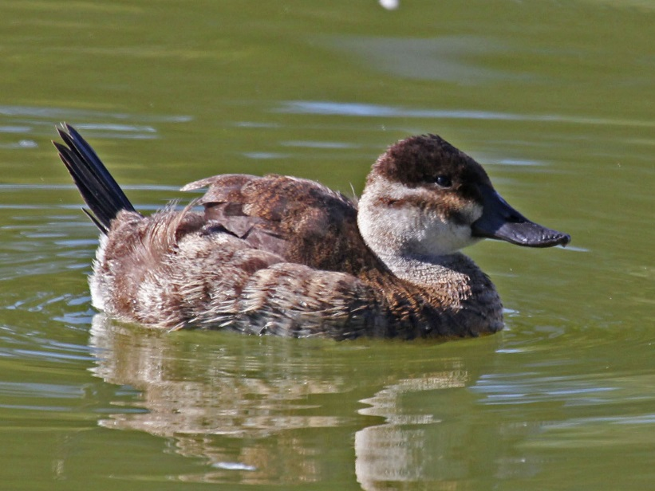
Ruddy Duck
Oxyura jamaicensis
Male
Female
© GBNNSS
By Dick Daniels (http://carolinabirds.org/)
Notes:
A small, compact diving duck of freshwater lakes and lowland wetlands.
Both sexes have stiff tale which is often held erect, giving distinctive profile.
Males in breeding plumage unmistakable. Bright chestnut body, large white cheek patch contrasting with black cap and bright blue bill. Females are less distinctive, medium brown all over but with distinctive facial pattern; dark cap and forehead contrasting with paler cheek intersected by diffuse horizontal stripe. Winter male similar to female, but bright white cheek is retained.

Slide 12
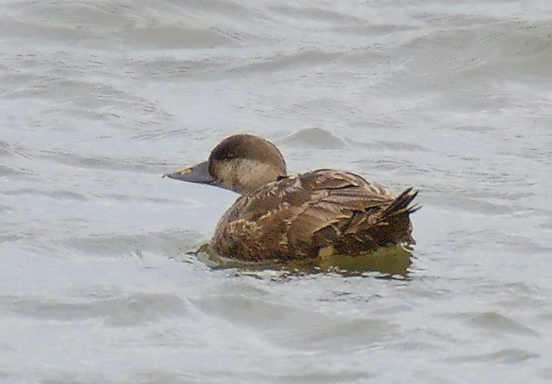
Ruddy Duck
Oxyura jamaicensis
Confusion Species: Female Common Scoter Melanitta nigra
Always shows trace of yellow in bill
Different habitats to Ruddy Duck (predominantly marine)
Female Common Scoter. Photo credit Stefan Berndtsson
Notes:
A number of female ducks are brown and could initially be confused with Ruddy Duck e.g. Tufted Duck or Smew.
Most similar looking is female common scoter, but they are uncommon on freshwater bodies and always show bulbous bill with at least a trace of yellow. Ruddy ducks are extremely rare in coastal habitats e.g. on the sea, in harbour or estuaries. Any birds found on inland freshwater bodies should be scrutinised.

Slide 13
Ruddy Duck
Oxyura jamaicensis
Previously popular duck in captive collections. Initially escaped Slimbridge WWT in 1950s.
By 2000, over 6000 birds were present in the wild across the UK, and breeding populations established in France, Belgium, the Netherlands and Spain.
Birds seen in Morocco, Iceland and Finland are believed to stem from introduced populations.
Breed on lakes with wide, reedy fringes where they build floating nests.
Cull has been highly successful with fewer than 30 birds left in UK.
Notes:
Native to North America. Captive birds at WWT Slimbridge escaped and began breeding.
Population expanded uncontrolled until 2000, when 6000 birds were present in the wild.
Breeds from May onwards, with most broods hatching in July.
Cull began in 2005
So far cost £15 million but has been highly successful. Last few remain and need to be targeted to prevent population expansion occurring again.
Ruddy duck is listed under Schedule 9 to the Wildlife and Countryside Act 1981 with respect to England, Wales and Scotland. As such, it is an offence to release or allow the escape of this species into the wild.

Slide 14
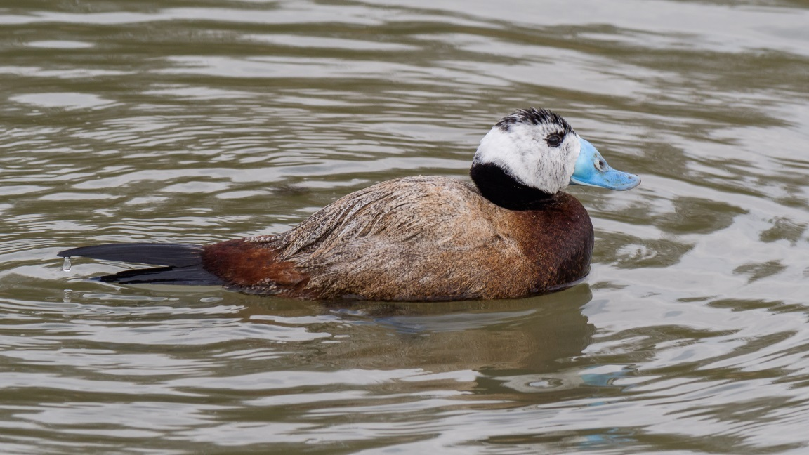
Ruddy Duck
Oxyura jamaicensis
Impact:
Readily hybridises with wild populations of the endangered White-headed Duck in Spain
Male White-headed Duck (Oxyura leucocephala).
Photo credit Mike Prince.
By Mike Prince from Bangalore, India - White-headed Duck, CC BY 2.0
Notes:
Ruddy Duck became an issue when it reached Spain and began to hybridise with the native and endangered White-headed Duck. It is the only ‘stifftail’ to occur in Europe naturally, and breeds in Russia and Kazakhstan, winters in Mediterranean. Numbers have crashed from 100,000 to just 10,000 over the last centaury, due to hunting and habitat destruction.
In Spain where there is a resident population, at the start of a recovery program, just 22 birds remained in 1977. Now there are 2,500 and it is seen as a key conservation success and an essential story in supporting effort for more efforts to reduce hunting and protect habitats.
Ruddy Duck posed a serious threat to their survival. Also spread east to wintering grounds of migratory populations would be catastrophic therefore cull was initiated and has been highly successful. Cull is ongoing, and sightings should be sent to i-record

Slide 15
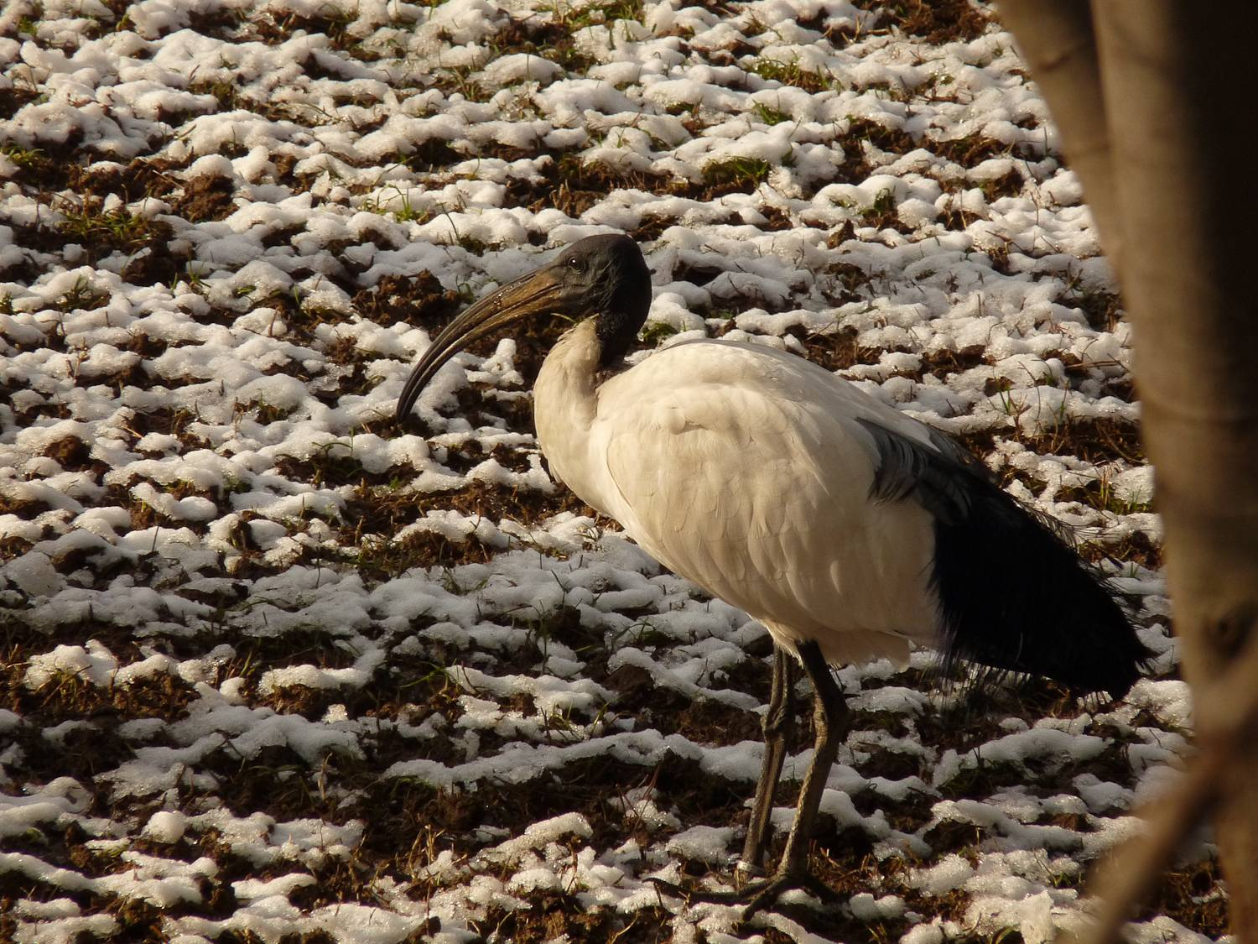
Sacred Ibis
Threskiornis aethiopicus
Photo by Sugoto Roy
Long, down-curved black bill.
All black featherless head
All-white body with black tips to wings
Long black legs
Notes:
Large ibis, up to twice the size of most common UK waders e.g. Avocet or Oystercatcher.
Plumage and size make this bird distinctive, even in flight. Dark head, de-curved black bill and black wing tips distinguish it from Spoonbill, the only other mostly-white closely related species.
If seen well, unmistakeable.

Slide 16
Sacred Ibis
Threskiornis aethiopicus
Mainly inhabits wet grassland and other shallow wetlands, but is highly adaptable and will use human sites to scavenge.
Records in the UK likely escapees, either from UK or continental Europe.
Breeds in colonies, sometimes with herons and egrets.
Few records in the UK and not yet established.
Notes:
Likely to be found around wetlands or on estuaries, however discovery around human habitations is possible.
During the 1970s and 1980s, several zoos attempted to establish free-flying breeding populations in their grounds. This resulted in birds spreading, with over 1000 pairs now breeding at several sites in France.
There have been at least 30 records of free-flying birds from England and Wales. They are yet to establish, but considering their highly-adaptable nature and the ease with which they’ve colonised in France, they are considered to be a threat here.
Sacred Ibis is listed under Section 14 of the Wildlife and Countryside Act 1981 with respect to England, Wales and Scotland. As such, it is an offence to release or allow the escape of this species into the wild.

Slide 17
Sacred Ibis
Threskiornis aethiopicus
Impacts:
Considered a general nuisance where invasive.
Predator of native species, and has had significant impact on tern colonies in France.
Notes:
General nuisance around human habitations, raiding bins and landfill sites.
Predates native fish, amphibians and eggs, and is a potential competitor. In France, has disturbed Tern colonies, predating eggs and chicks and having a significant impact. It was reported that just two birds ate the chicks and eggs of an entire colony of Sandwich Tern (30 nests) in just 4 hours. Likely to have similar impacts if they become established here.

Slide 18







Reporting
Any sightings of North American Bullfrog, African Clawed Toad, Ruddy Duck, or Sacred Ibis in the UK should be reported – with a photograph and accurate location if possible.
Report sightings by using iRecord (https://www.brc.ac.uk/irecord/ or the iRecord app) or by emailing alertnonnative@ceh.ac.uk

Slide 19
Find out more about invasive plants and animals at www.nonnativespecies.org
More information about the RAPID LIFE Project (including free downloads of these materials) can be found at www.nonnativespecies.org/rapid
Want to know more?

