Slide 1
Invasive Species Activity
Today we are going to learn about invasive species.
What they are
Why they are a problem
How we can help to protect our wildlife and crops

Slide 2
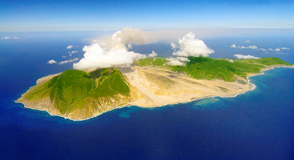
Plants and animals on Montserrat
Our island is home to lots of different plants and animals.
Many have always been found in Montserrat and are called native species.
Some are very rare and not found in any other part of the world. It’s very important that we look after them.

Slide 3
Plants and animals on Montserrat
There are other plants and animals that people have brought to Montserrat from other parts of the world, either by accident or on purpose.
Some are harmful to our native species or the plants that we grow for food – sweet potatoes, breadfruit, bananas and guava.
These harmful species are called invasive species.

Slide 4
Invasive species
Invasive species can harm other plants or animals by:
Eating them.
Eating their food or taking over the places that they live.
Spreading diseases which harm them.
The problems they cause can also be very expensive.

Slide 5
Activity one: Native or Invasive
You are going to look at some plants and animals to work out:
whether they are native or invasive species.
what they are.
Native species have always been found on Montserrat. Some are very rare.
Invasive species have been brought to Montserrat by people and harm other plants and animals.

Slide 6
Activity one: Native or Invasive?
Answers

Slide 7
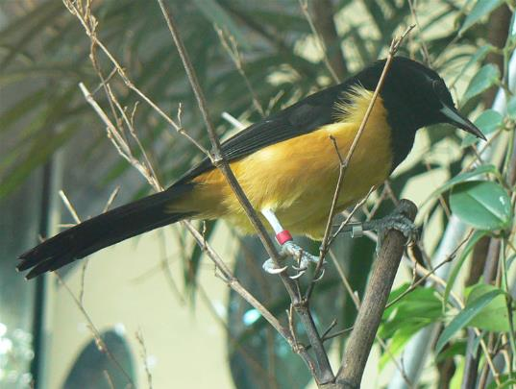
Activity one - answers
What is this?
Is it native or invasive?
Image: Neil Phillips via Wikimedia commons

Slide 8
Activity one - answers
Montserrat oriole
Is this native or invasive?
Image: Neil Phillips via Wikimedia commons

Slide 9
Activity one - answers
Montserrat oriole
This is a native species
Image: Neil Phillips via Wikimedia commons

Slide 10
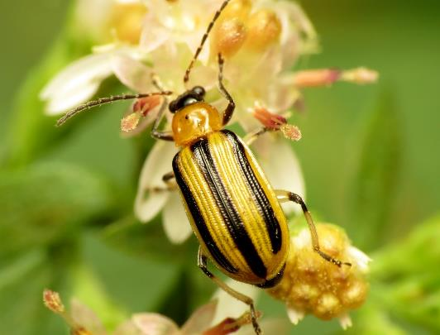
Activity one - answers
What is this?
Is it native or invasive?
Image: Katja Schulz via Wikimedia commons

Slide 11
Activity one - answers
Cucumber beetle
Is it native or invasive?
Image: Katja Schulz via Wikimedia commons

Slide 12
Activity one - answers
Cucumber beetle
This is an invasive species
Image: Katja Schulz via Wikimedia commons

Slide 13
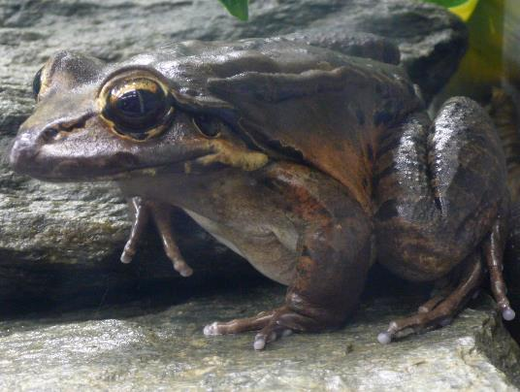
Activity one - answers
What is this?
Is it native or invasive?
Image: Tim Vickers via Wikimedia commons

Slide 14
Activity one - answers
Mountain chicken
Is it native or invasive?
Image: Tim Vickers via Wikimedia commons

Slide 15
Activity one - answers
Mountain chicken
This is a native species
Image: Tim Vickers via Wikimedia commons

Slide 16
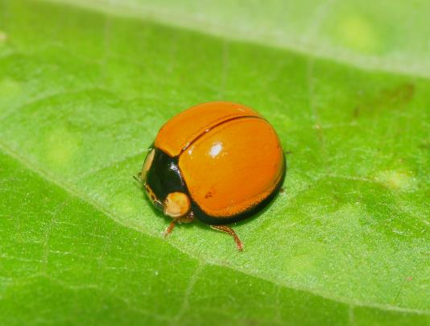
Activity one - answers
What is this?
Is it native or invasive?
Image: Pavel Kirillov via Wikimedia commons

Slide 17
Activity one - answers
Ladybird
Is it native or invasive?
Image: Pavel Kirillov via Wikimedia commons

Slide 18
Activity one - answers
Ladybird
This is a native species
Image: Pavel Kirillov via Wikimedia commons

Slide 19
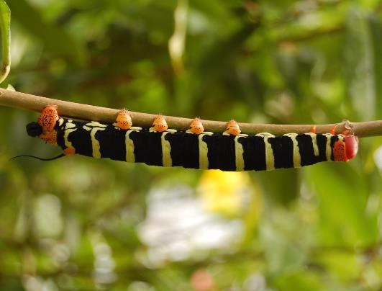
Activity one - answers
What is this?
Is it native or invasive?
Image: KoS via Wikimedia commons

Slide 20
Activity one - answers
Frangipani hawkmoth caterpillar
Is it native or invasive?
Image: KoS via Wikimedia commons

Slide 21
Activity one - answers
Frangipani hawkmoth caterpillar
This is an invasive species
Image: KoS via Wikimedia commons

Slide 22
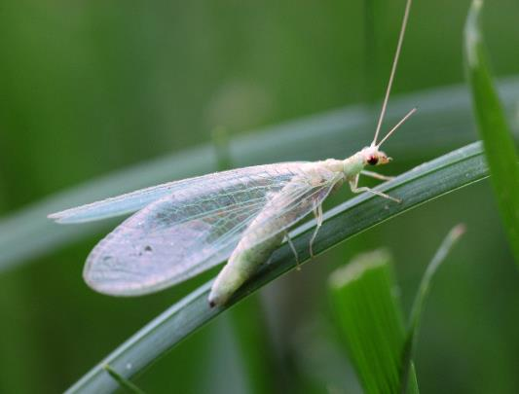
Activity one - answers
What is this?
Is it native or invasive?
Image: Siamese puppy via Wikimedia commons

Slide 23
Activity one - answers
Lacewing
Is it native or invasive?
Image: Siamese puppy via Wikimedia commons

Slide 24
Activity one - answers
Lacewing
This is a native species
Image: Siamese puppy via Wikimedia commons

Slide 25
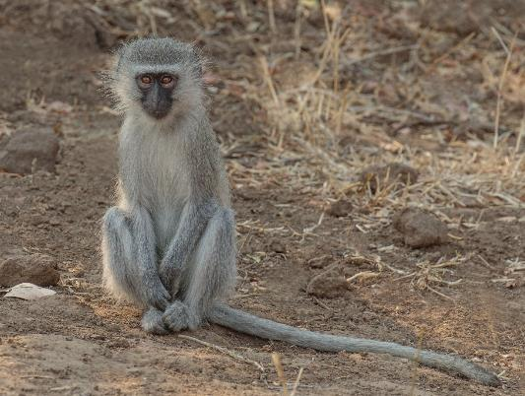
Activity one - answers
What is this?
Is it native or invasive?
Image: Andy Morffew via Wikimedia commons

Slide 26
Activity one - answers
Vervet monkey
Is it native or invasive?
Image: Andy Morffew via Wikimedia commons

Slide 27
Activity one - answers
Vervet monkey
This is an invasive species that hasn’t been found in Montserrat yet but could arrive in future
Image: Andy Morffew via Wikimedia commons

Slide 28
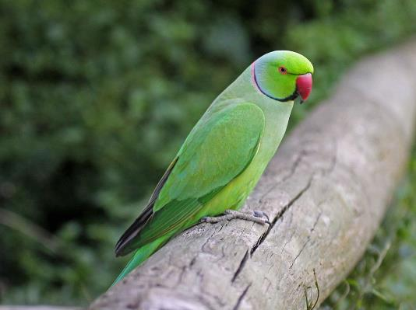
Activity one - answers
What is this?
Is it native or invasive?
Image: Dick Daniels via Wikimedia commons

Slide 29
Activity one - answers
Parakeet
Is it native or invasive?
Image: Dick Daniels via Wikimedia commons

Slide 30
Activity one - answers
Parakeet
This is an invasive species that hasn’t been found in Montserrat yet but could arrive in future
Image: Dick Daniels via Wikimedia commons

Slide 31
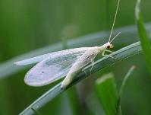
Activity one - answers
Native
Invasive

Slide 32
Activity two: Detective challenge
There are four reports of invasive species causing problems in Montserrat.
Go through each case one by one and work out:
How the invasive species got to Montserrat.
What we could do to stop this happening again
Look at the clues if you need to and write your answers down on the worksheet.

Slide 33
Activity two: Detective challenge
Answers

Slide 34
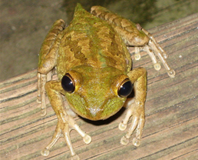
Activity two - answers
Case 1
An invasive Cuban tree frog has been found in the wardrobe of someone’s house.
How did the frog get from Cuba to a wardrobe in Montserrat?

Slide 35
Activity two - answers
Case 1
The owner of the house went on holiday and the frog crawled into their suitcase without them realising. When they got home it crawled out into their wardrobe.

Slide 36
Activity two - answers
Case 1
The owner of the house went on holiday and the frog crawled into their suitcase without them realising. When they got home it crawled out into their wardrobe.
How could we stop this from happening again?

Slide 37
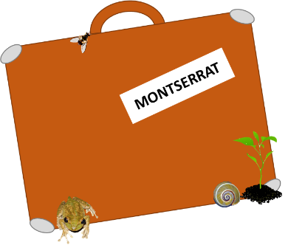
Activity two - answers
Case 1
We could stop this from happening again by telling everyone to check their luggage for hitchhikers before coming to Montserrat.

Slide 38
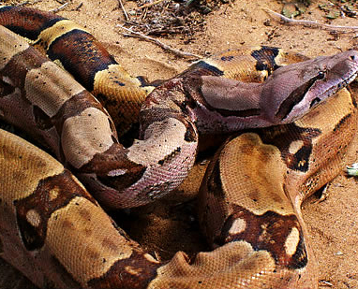
Activity two - answers
Case 2
An invasive boa constrictor snake from South America has been rescued from a park.
How did the snake end up in a park in Montserrat?
Image: Tod Baker

Slide 39
Activity two - answers
Case 2
The snake was brought to Montserrat as a pet but dumped in the park when it become too large for the owner to look after.
Image: Tod Baker
How could we stop this from happening again?

Slide 40
Activity two - answers
Case 2
We could stop this from happening again by taking care of our pets and never releasing them into the wild where they could hurt other animals, or be hurt themselves.
Image: Tod Baker

Slide 41
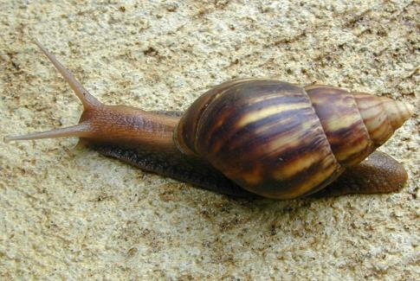
Activity two - answers
Case 3
A farmer has found a giant African land snail in one of their fields.
How did the snail end up in a field in Montserrat?
Image: Eric Guinther

Slide 42
Activity two - answers
Case 3
Some of the farm workers visited a farm in Antigua and stepped in mud with snail eggs in it. When they got back to Montserrat the eggs came off their boots and hatched into snails.
Image: Eric Guinther
How could we stop this from happening again?
We could stop this from happening again by telling everyone to clean their footwear before coming to Montserrat.

Slide 43
Activity two - answers
Case 3
We could stop this from happening again by telling everyone to clean their footwear before coming to Montserrat.
Image: Eric Guinther

Slide 44
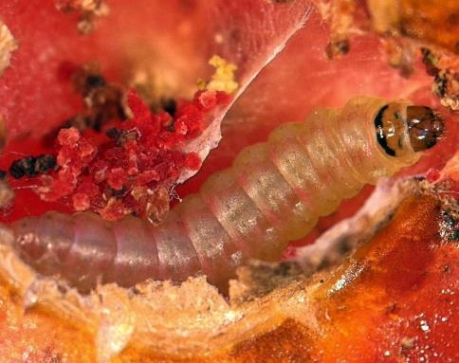
Activity two - answers
Case 4
Someone has found a tomato leaf miner caterpillar in their lunchbox.
How did this caterpillar end up in a lunchbox in Montserrat?
Image: Marja van der Straten/NVWA Plant Protection Service/Bugwood

Slide 45
Activity two - answers
Case 4
The caterpillar was in a tomato imported from abroad.
Image: Marja van der Straten/NVWA Plant Protection Service/Bugwood
How could we stop this from happening again?

Slide 46
Activity two - answers
Case 4
We could stop this from happening again by looking out for any pests in our fruit and vegetables.
Image: Marja van der Straten/NVWA Plant Protection Service/Bugwood

Slide 47
What have we learned today?
Invasive species are plants and animals that are from other parts of the world and been brought to Montserrat by people.
They can harm our wildlife and food crops by:
Eating them.
Eating their food or taking over the place that they live.
Spreading diseases which harm them.

Slide 48
What have we learned today?
Some of the ways that invasive species can be spread are:
As hitchhikers in luggage.
As unwanted pets dumped in the wild.
In mud or soil carried on footwear and car tyres.
In food which is imported from abroad.

Slide 49
What have we learned today?
We can help protect our wildlife and crops by:
Checking luggage for hitchhikers before coming to Montserrat.
Looking after our pets.
Cleaning footwear and car tyres before coming to Montserrat.
Checking our food for pests.

Slide 50
Extension activity (optional)
Design a poster to tell others about invasive species and what they can do to stop them from spreading

