Slide 1
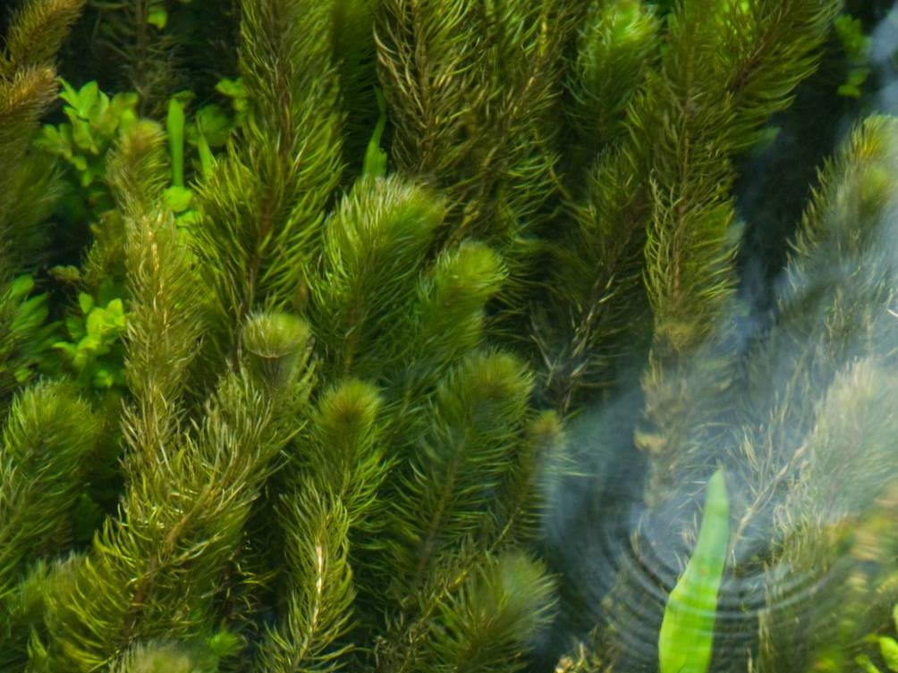
FRESHWATER INVASIVE NON-NATIVE SPECIES
Name of presenter

Slide 2
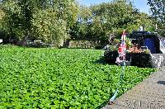
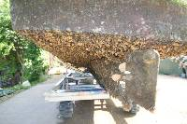
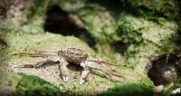
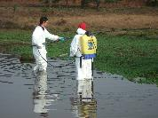
Freshwater Invasive Non-Native Species
Impacts on Event Managers and Practical Biosecurity Steps
Notes:
Images © GB NNSS

Slide 3
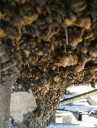
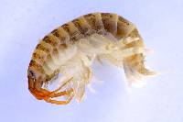
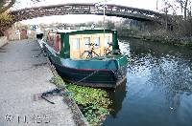
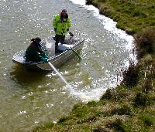
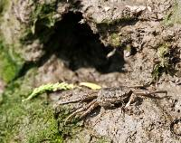
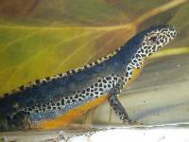
What are Non-Native Species?
Non-Native Species (NNS) are outside their native range because of people.
Non-native Species becoming a problem are called ‘invasive’ (INNS).
NNS can also be called ‘non-indigenous’ or ‘alien’ species (IAS: Invasive Alien Species)
Notes:
I’m going to talk to you today/tonight about the threat from invasive non-native species, or INNS, in the freshwater environment and what we can do about it. I have a presentation which will take about half an hour which I hope will give you a useful insight into the world of invasive non-native species. I am happy to take questions at the end.
By the end of this short presentation I hope I will have given you not only a useful insight into the world of invasive species but also shown you that there are many actions we can all take to reduce the risk of their spread and reduce the impact of their growth.
Images: Alpine newt © Anevrisme; Hydroctyle ranunculoides weed extraction boat, Crown Copyright 2009; Rotenone application © Matt Brazier, Environment Angency; Killer shrimp © Environment Agency; Mitten crab © GB NNSS, Zebra mussels © Crown Copyright 2009

Slide 4
Notes:
Link to video on YouTube. Requires web access and can take a minute to load and play.
Here is the link in case the one within the Powerpoint doesn’t work: https://www.youtube.com/watch?v=EoggtzYr4Qk

Slide 5
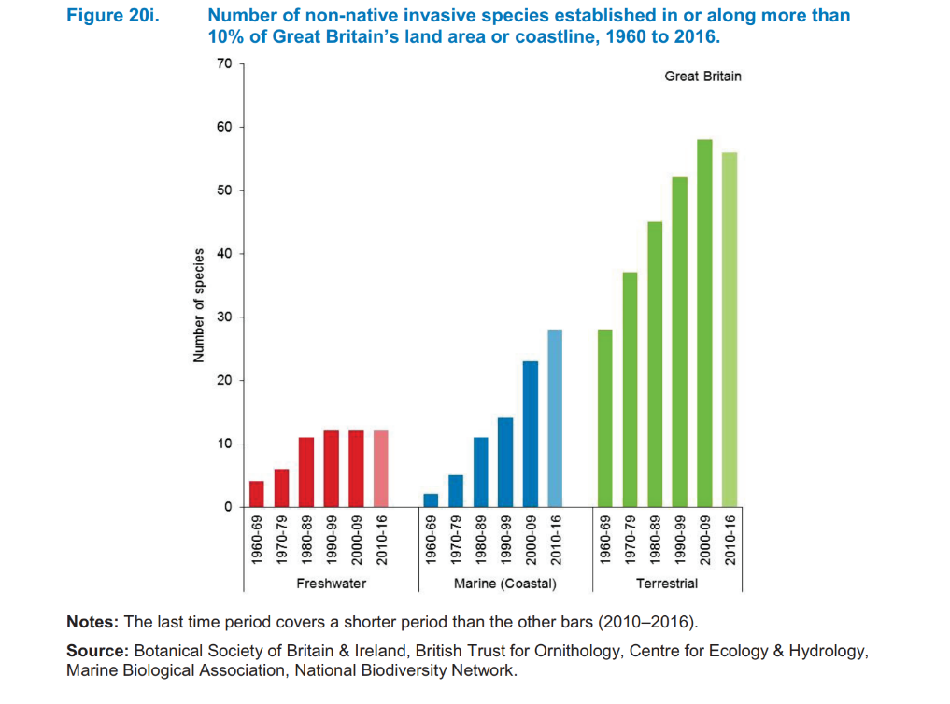
Ever Increasing Invasives
Notes:
Invasive non-native species, also known as alien species, are increasing across the UK, both in the sea and on the land, more than 10 per cent of Great Britain’s land area or coastline now has established populations of invasive species.
But SO WHAT?!

Slide 6
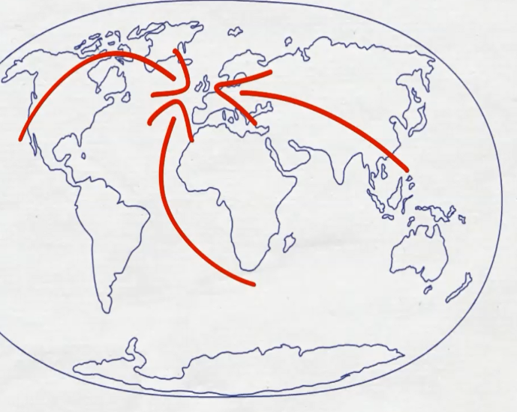
Routes of Participants (and Invasive Species)
Notes:
As an event manager you may be involved in the management of angling competitions, boat races, or triathlons with people coming from across the UK, or possibly from across the world.
These events play a vital social and economic role in communities where they occur and they are also very important as platform for competition.
However, they also have the potential to import INNS from far afield and with new laws in place in many countries, you need to understand your responsibility to minimise the risk from invasive non-native species.

Slide 7
Schedule 9 example species
Chinese Mitten Crab Eriocheir sinensis
Large-mouthed Black Bass Micropterus salmoides
Rock Bass Ambloplites rupestris
Bitterling Rhodeus sericeus
Noble Crayfish Astacus astacus
Signal Crayfish Pacifastacus leniusculus
Turkish Crayfish Astacus leptodactylus
American Mink Mustela vison
Alpine Newt Triturus alpestris
Italian Crested Newt Triturus carnifex
Pumpkinseed (Pond perch) Lepomis gibbosus
Wels (European catfish) Silurus glanis
Zander Stizostedion lucioperca
BIOSECURITY PLAN
----------------------------------------------------------------------------------------------------------------------------------------------------------------------------------------
-----------------------
-----------------------
-----------------------
------------------------------------------------------------------------------------------------------------------------------------------
----------------------------------------------
Notes:
The law in the UK varies. In England The Wildlife and Countryside Act 1981, and its various amendments, is the most important piece of legislation dealing with INNS.
The Act makes it illegal to release, plant or allow to escape into the wild any animal or plant which is not ordinarily resident, or a regular visitor to Great Britain, or is listed in Schedule 9 of the Act. Don’t worry too much about lists – getting caught up in identifying every species can be a fascinating, but lengthy, distraction!
You may also be aware of other pieces of legislation such as The European Strategy for Invasive Alien Species, the EU Invasive Alien Species regulation or the European Water Framework Directive.
The key thing to remember is that throughout the UK the principle of ‘polluter pays’ remains in force. Should the introduction of an invasive non-native species be attributed to your event there is the potential for you to be held accountable for the clean-up.

Slide 8
Demonstrate you have followed ‘best practice’
Aiming to demonstrate action against statements such as:
“Adopt a precautionary approach”
“Carry out risk assessments”
“Seek advice and follow good practice”
“Take reasonable steps and exercise due diligence”
Notes:
Avoiding this situation is not as difficult as you may at first suspect. Controlling INNS once they have arrived, is very difficult, particularly in connected waterways such as rivers and canals, and so legislators have avoided being too prescriptive about how to do it and they emphasise the use of preventative measures such as those identified during biosecurity planning rather than encourage control once INNS are installed. They request people ‘follow best practice’, mostly allowing users to define what is most appropriate for themselves.

Slide 9
Public Expectations
Legal Challenge
Investor
Confidence
Members Expectations
Market Advantage
Risk Management
Planning
Restrictions
Legislation
Suppliers
Environmental
Damage
Customers
Reputation
European Water Framework Directive
Wildlife and Countryside Act 1981
Notes:
Running an event is time consuming and complex. The last thing you want is another task to add to the list. However, if you introduce practical measures to reduce biosecurity risks at the beginning of planning your event you will soon discover that it will become second nature and save you a lot of effort in the long run.

Slide 10
Biosecurity Risk Assessment
Likelihood of establishment and spread
Effectiveness of vector
Risk
Vector association with NNS
Receiving water or plants dissimilar to home waters?
Water in hull
Plants caught in equipment
Damp wetsuits or boots
Risk
Canoeists
Notes:
The essence of good biosecurity for events is to identify the high-risk activities and then ensure that everyone plays their part in reducing that risk.
An example risk would be canoeists who move from one water body to another in one day

Slide 11
Working with Contractors
Share responsibility by taking opportunities to write biosecurity expectations into contracts.
For example:
The contractor must submit a Biosecurity Risk Assessment for written approval at least 6 weeks prior to commencement of the works.
The contractor must ensure that all equipment, materials, machinery and PPE used are in a clean condition prior to their arrival on site to minimise risk of introducing INNS into the environment.
Notes:
In organising your event you may be working with a wide range of people, from participants, including their helpers, friends and family, through to professional contractors.
With both groups it is key to raise biosecurity early and be clear about what you expect.
With professional contractors it is important to write your expectations into your agreement with them. Some examples are:
The contractor must submit a Biosecurity Risk Assessment for written approval at least 6 weeks prior to commencement of work.
The contractor must ensure that all equipment, materials, machinery and PPE used are new or are thoroughly cleaned prior to their arrival on site.

Slide 12
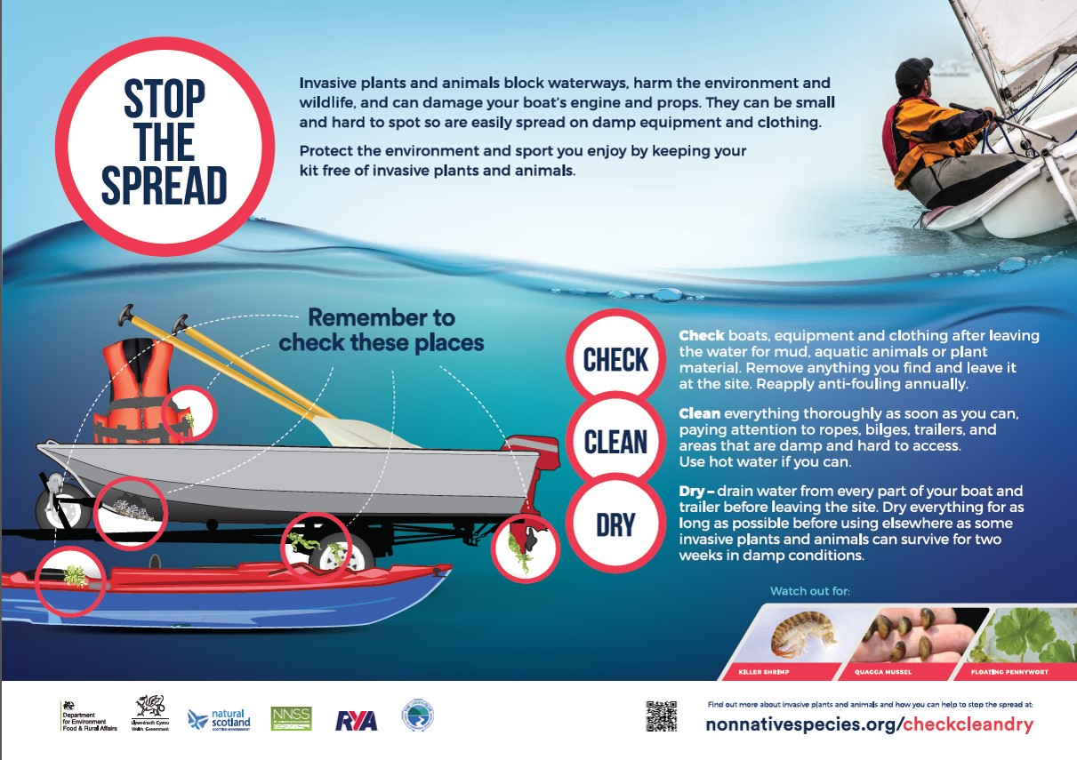
Check, Clean, Dry
Notes:
For participants the key is to give them enough warning to ensure they have time to clean their boats and kit effectively.
Ask all participants to ‘Check Clean Dry’ before they leave home (making sure all washdown and scraping material is disposed of appropriately) and before they leave your site. You could raise the issues through the relevant club or association and you can also include guidance in the event paperwork – from when they register to inclusion in the rules of the day.

Slide 13
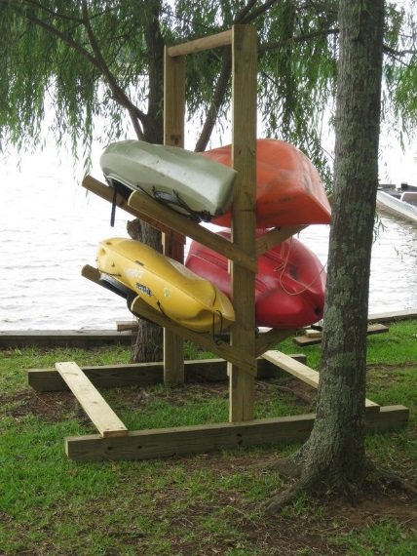
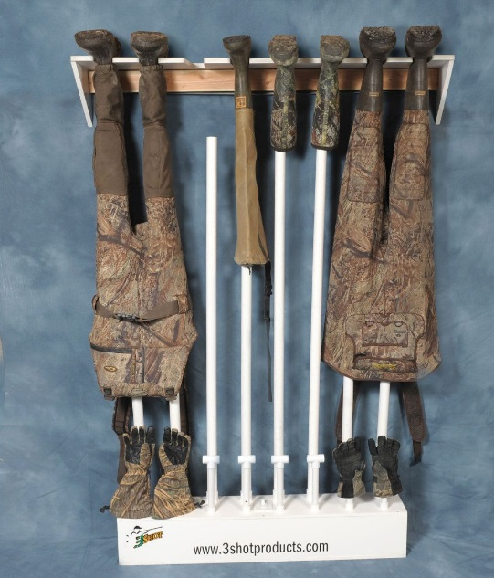
Drying racks
Provide drying racks near entry and exit points
Install racks and a dehumidifier in an indoor room for waders and boots
Post “Check, Clean, Dry” information in these areas
Notes:
Consider installing racks for people to drain and dry equipment. This could be near the entry and exit access points for canoes, or in a small room in a clubhouse or bait store for waders and boots. Inside, consider installing a dehumidifier which will speed up drying considerably.
Photo credits: Photo © Gander Mountain Gear; Photo ©jaxkayakfishing.com

Slide 14
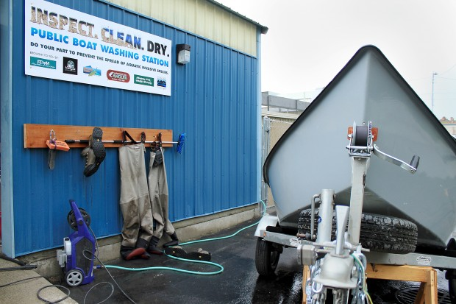
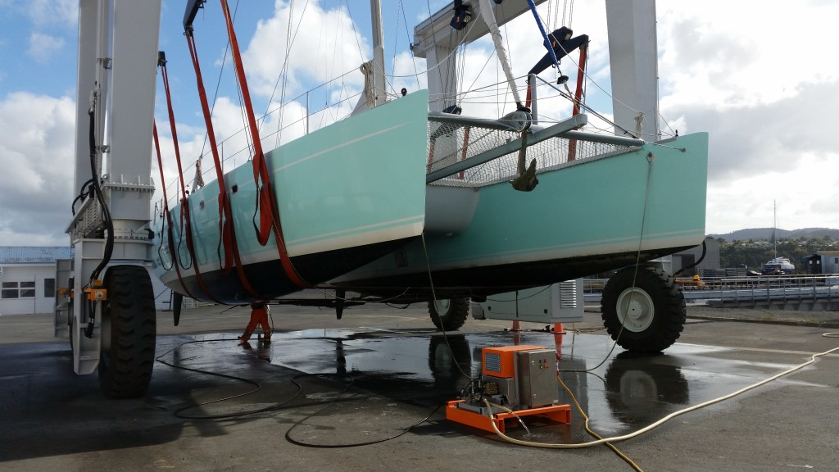
Cleaning stations
On the site, wherever possible, you should have cleaning/washing facilities
Appropriate scale for the event
Well away from the water’s edge
Appropriate drainage and disposal
Notes:
On the site it is important to have relevant cleaning facilities – this will range from, for a triathlon or kayaking event, a simple wash down area, well away from the water’s edge, through to a full lift and scrub facility for larger vessels such as canal boats.
Images: Sail Catamaran on Washdown Pad at Port Whangarei Marine Centre © http://portwhangarei.com; public washing station © Copyright https://www.umowa.org/articles/2018/4/6/umowa-boat-washing-station
(Good to emphasise = residues from wash down may include live material along with cleaning solutions. )

Slide 15
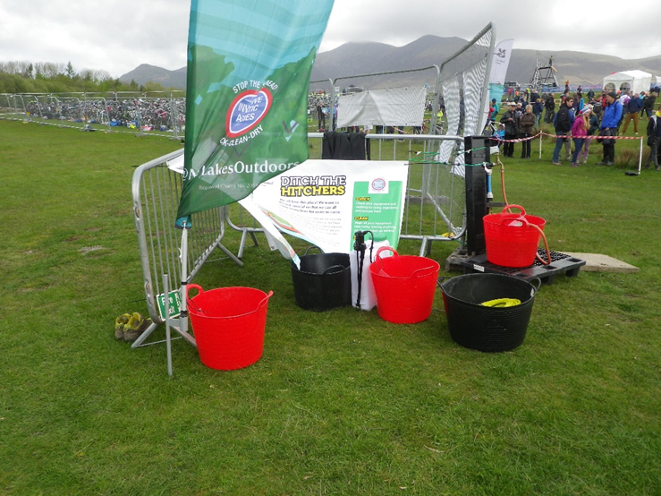
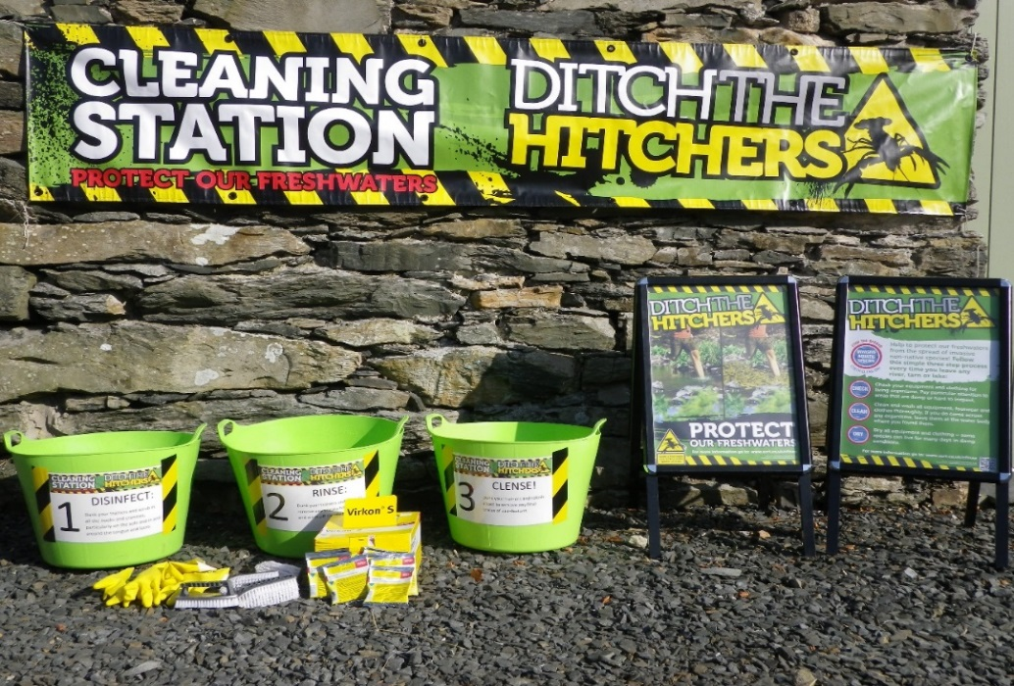
Washing station
Portable washing station with three buckets:
first for removing mud or other organic material
second for cleaning thoroughly
third for rinsing
Change water often and dispose of appropriately!
Notes:
If you don’t have a permanent washing station, for events such as tri-athlons or kayaking competitions, you can create a portable washing station
Images: Washing stations © CFINNS

Slide 16
Communication Tools
Notes:
Send out links or copies of biosecurity information, such as Clean, Check, Dry, beforehand.
Be clear that you expect nothing but clean boats and kit to arrive and clean boats and kit to leave the site. Remember that it is just as important to stop INNS leaving the site as it is to stop them arriving.
Providing a briefing for any volunteers or staff working at the event is important. They don’t need to be freshwater biologists to assist with identifying invasive species, they just need to be enthusiastic about boat and kit hygiene and feel comfortable about reporting any concerns.
It will probably never happen, but telling participants that boats or kit which are wet or fouled will not be allowed to take part, sends a very clear message about what you expect from participants.
Whichever way you choose to do it, make sure the participants know well in advance that you want to see only clean hulls and kit arriving on site.
A word of comfort here – evidence suggests that following the CCD advice and carrying no sediments, on trailers for example, then they remain at very low risk.

Slide 17
Biosecurity Planning
Notes:
Preventative Medicine
So how does all this relate to the legislation we discussed earlier?
In essence, by undertaking these actions you are demonstrating ‘best practice’. By recording it all in one document – your biosecurity plan – you can show anyone who may have concerns about your activities that you are taking all reasonable steps to lower the risk of the event introducing or spreading invasive non-native species.
Biosecurity Planning
You can take this one step further and do a full biosecurity plan for your event. This involves a five step process. Templates and examples are available on the website.
Images: © CFINNS

Slide 18
Section 1 - Introduction
Why are you writing a biosecurity plan?
What are the major concerns for our business?
BIOSECURITY PLAN
----------------------------------------------------------------------------------------------------------------------------------------------------------------------------------------
-----------------------
-----------------------
-----------------------
------------------------------------------------------------------------------------------------------------------------------------------
----------------------------------------------
Notes:
Step 1 – Introduction
Your opening section sets the scene for why you are doing a biosecurity plan and what the major concerns are for your event. For example, you may be concerned about effects on the environment and legal or reputational impacts.

Slide 19
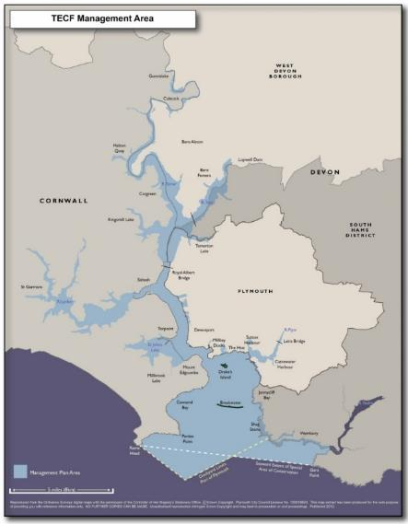
Section 2 – Scene Setting
Background to the plan
Geographical scope
Time limits of plan
Review and update schedule
Activities
Useful contacts
Local Natural England staff
Relevant experts, freshwater biologists, biosecurity experts, university contacts etc.
Fig 1: TECF Management Area
Notes:
Step 2 – Scene Setting
Here you identify what geographical area or activity is to be covered by the plan, who has responsibility for the Plan and how and when it will be reviewed and updated.
Map source: (example map from the Tamar Estuary Biosecurity Plan): http://web.plymouth.gov.uk/tecf

Slide 20
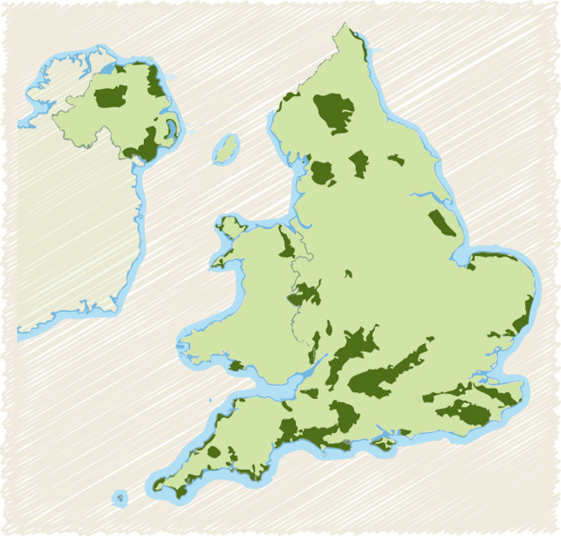
Section 3 – Environmental Information
Physical structure and layout of the site
Water flow, temperature and other relevant data
Lists of INNS known to be present or on the horizon
Existing designations e.g. SSSI or AONB, etc.
Areas of Outstanding Natural Beauty (AONBs) http://www.landscapesforlife.org.uk/about-aonbs/visit-aonbs/
Notes:
Step 3 - Environmental Information
In this section you should delve into more detail about the physical characteristics of the area covered by the Plan. Gather as much information as you can about the waters local to your event – this will give you a much better idea about the risk from invasive species. For example if the water is an area with little inflow and outflow, such as a lake, the biosecurity risk for spreading downstream may be less and more easily controlled. Also find out about any existing management arrangements for example, is the area a SSSI (Site of Special Scientific Interest) or have other protected status such as an AONB (Area of Outstanding Natural Beauty)? If so contact Natural England to find out more about INNS and current management of marine protected areas locally.
Also have a look at the known, and anticipated invasive species in the area – this will help with prioritising actions as well as identification.

Slide 21
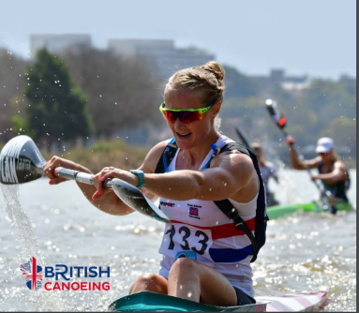
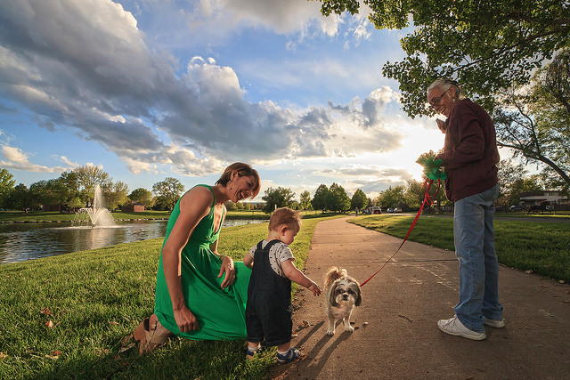
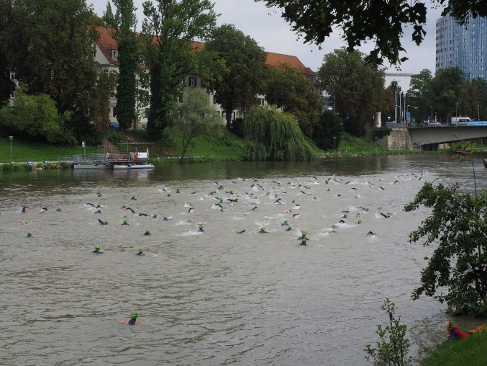
Section 4 – Use of the Area
Major types of activity
How many users?
What do they bring and what do they take away?
Where are they coming from?
Are they coming from another water body?
Notes:
Step 4 - Use of the Area
Here you will list the major types of activity you expect at the event. For instance, for a kayaking competition, how many boats would you expect, where are they coming from? Would any of them have recently been in another water body?
(images from British Canoeing and AJ Shroetlin | Creative Commons)

Slide 22
Section 5 – Biosecurity Actions
Encourage participants to arrive and depart with clean, dry equipment.
Always wash down well away from the water’s edge to ensure that no residues can return to the water body.
Encourage reporting of unusual sightings.
Designate a Biosecurity Officer.
Notes:
Step 5 - Biosecurity Actions / Control measures
Perhaps the most important section. Here you outline the actions you plan to take to improve your biosecurity. We’ve discussed some of these actions already and what you choose to do will vary depending upon the activities and partners involved and the risk associated with the activities and the site. Aim to stay practical – you can always include a ‘wish list’ of other actions should time and budget allow.

Slide 23
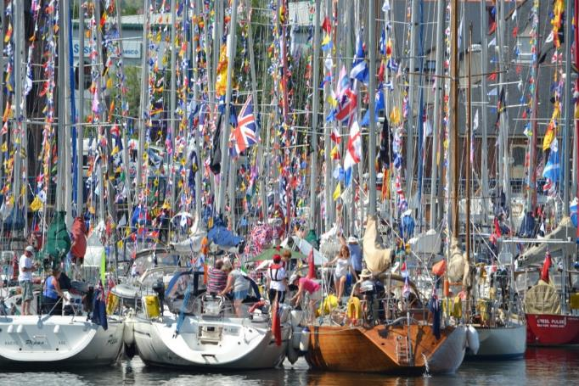
Commonwealth Games Flotilla 2014
Notes:
You may have been listening to all this and thinking ‘but does anyone really DO this?’. Let me give you a short case study before we have a chance for questions.
In 2014 the Commonwealth Games were held in Glasgow. RYA Scotland felt this was too good an opportunity to miss and that, despite not being an official sport of the Commonwealth Games, boating should not be missed off the highlights list.
They got busy planning a flotilla of boats of all sizes to sail up the Clyde to the heart of the city. Very soon they had more than 200 boats signed up from all across the UK and as far afield as Northern Europe.
In the run up to this period the ‘Code of Conduct’ that accompanied the revised Wildlife and Natural Environment Act was released. The Code recommended that biosecurity planning would be considered best practice.

Slide 24
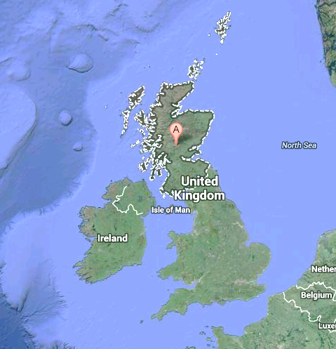
Sources of boats
Notes:
RYA Scotland sensibly decided to protect themselves by doing a biosecurity plan for the Flotilla which was now almost 250 boats strong. Working with the Firth of Clyde Forum they gathered publicly available data about salinity and water chemistry in the Clyde before assessing the available wash down facilities local to the venue.

Slide 25
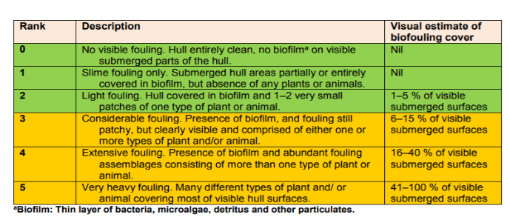
Critical Control Points
Pre departure preparation
Pontoon Contracts
Intervention Points
James Watt Dock
Contingency plan – Polluter Pays
Salinity – Peelports Data
Greenock 1.0182
Clydebank (Rothesay Dock) 1.0065
Glasgow King George V Dock 1.0055
Glasgow Broomielaw 1.0045
Plain water = 1.0
Greenock = fully saline, Broomielaw = almost fully fresh
GUIDANCE FOR PRODUCING SITE AND OPERATION-BASED PLANS FOR PREVENTING THE INTRODUCTION AND SPREAD OF INVASIVE NON-NATIVE SPECIES IN ENGLAND AND WALES. November 2015, R.D. Payne, E.J. Cook, A. Macleod & S. Brown
Notes:
In putting the Plan together they identified that the closest wash down was at James Watt Dock, the muster point prior to the final destination – this was then declared as the ‘Critical Control Point’ and volunteers were asked to keep an eye out for any boats with more than a sign of slight hull fouling as they arrived in the Dock. It was agreed that anyone arriving with hull fouling over level 3 would be asked to haul out and clean their boat or face not being allowed to join the flotilla.
In assessing the water chemistry the team realised that the boats were coming from an entirely maritime environment into one which was almost completely freshwater. This further reduced the risk of viable invasive species being introduced to the upper reaches of the Clyde.

Slide 26
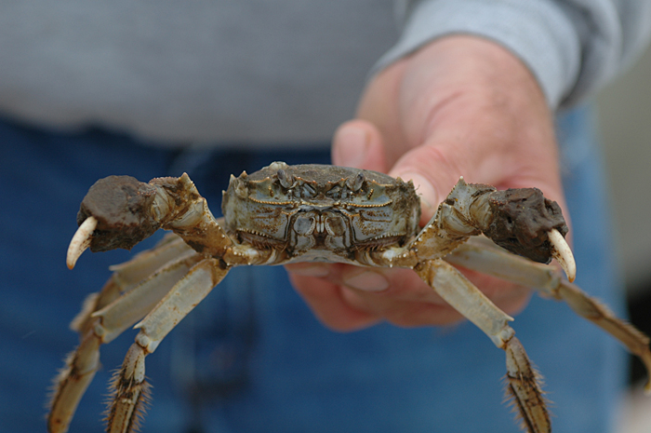
Not a moment too soon…..
Image © Greg Ruiz/Smithsonian
Notes:
On the day no boats arrived unclean, perhaps due to the nature of the event, but also thanks to the communications sent to boat owners in the run up to the event by The Green Blue.
The event went brilliantly and the biosecurity plan made the headlines, not just because it was the first of its kind, but also because it was needed when just weeks later a Chinese Mitten crab was found in the River. RYA Scotland was able to rest easy showing they had a biosecurity plan which exonerated them from potential blame.
So, as you can see, biosecurity planning can be relatively easy to achieve and can protect you and your event from possible reputational and legal risks.

Slide 27
Contacts
Report INNS sightings by using iRecord https://www.brc.ac.uk/irecord/ or the iRecord app or by emailing alertnonnative@ceh.ac.uk
GB Non-Native Species Secretariat www.nonnativespecies.org
National Biodiversity Network – Distribution maps and information www.nbnatlas.org
RAPID LIFE: www.nonnativespecies.org/rapid
Notes:
I’d welcome any questions and if I can’t answer any of them I promise to make a note and get back to you with answers as soon as possible.

